Slide 1

Guest Lecture at the Aichi Institute of Technology
Adrian Keil (M.Sc.) and Moritz Bosch (M.Sc.)
—
Introduction to DC-Grids

Slide 2
Section 01
—
Fraunhofer-Gesellschaft
Notes:
Fraunhofer-Gesellschaft zur Förderung der angewandten Forschung e. V., lit. 'Fraunhofer Society for the Advancement of Applied Research'

Slide 3

Fraunhofer-Gesellschaft [zur Förderung der angewandten Forschung e.V.]
At a glance
Applied research focusing on key future-relevant technologies and the commercialization of findings in business and industry. A trailblazer and trendsetter in innovative developments. → Transfer, economic and social impacts
Business volume of €3.6 billion
Contract research totaling €3.1 billion
Approx. 32,000 employees
Base funding from Germany’s federal and state governments
Industrial contracts and publicly funded research projects
75 institutes and research units
Founded 1949
>7.000 active patent families
3
May 13, 2026

Slide 4
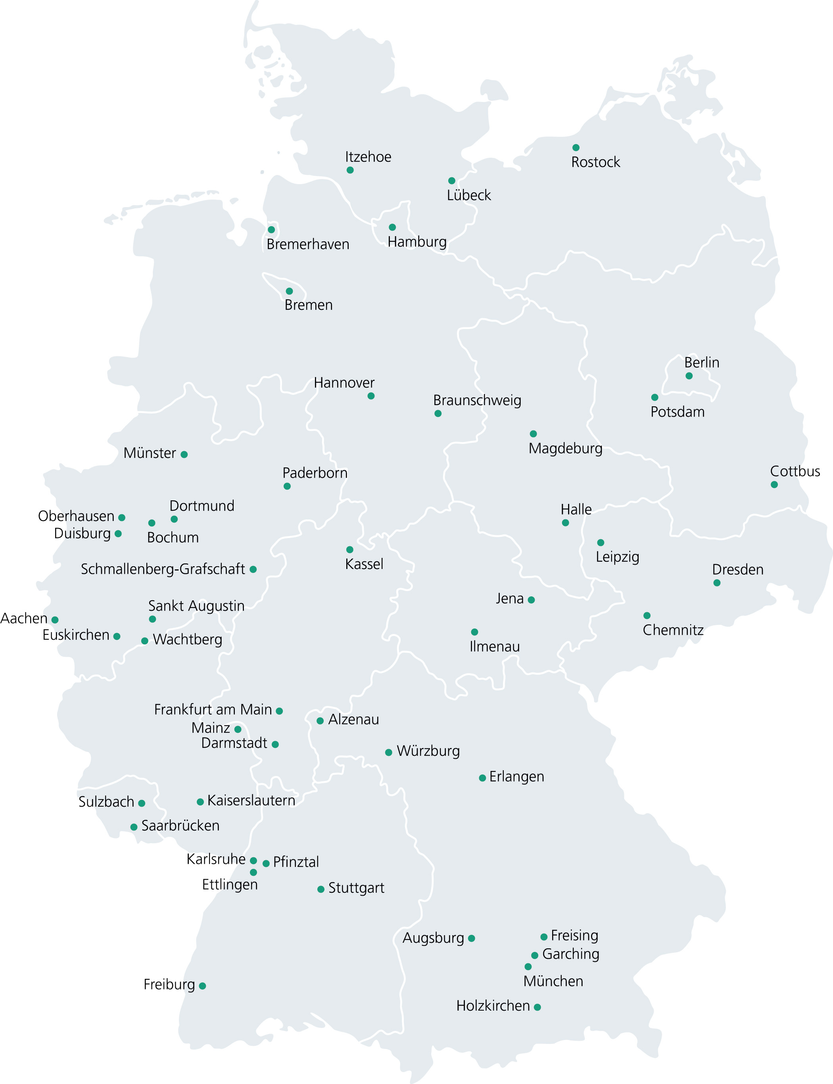
Fraunhofer-Gesellschaft
At a glance
€3.6 billion
Growth and additional research funding
€3.1 billion
One-third is base funding from Germany’s federal and state governments
Total business volume
Contract research
Two-thirds come from industrial contracts and publicly-funded research projects
Main locations of the Fraunhofer institutes and research units
2024
4
May 13, 2026

Slide 5


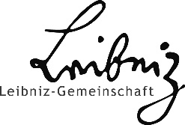

The Major Non-University Research Organizations
Wide-ranging research
Applied research and technology transfer
Higher education institutions
Training and research
Research programs and infrastructure
Knowledge-driven and applied basic research
Basic research
May 13, 2026
Notes:
Ansprechperson: Kerstin Rufer
-------------------------------
Kernaussage / Story
Das Wissenschaftssystem in Deutschland ist sehr gut ausdifferenziert. Sowohl die Hochschulen als auch die großen AUF haben ihre spezifischen Aufträge und Missionen. Es gilt, die Alleinstellungsmerkmale der Einrichtungen zu bewahren. → Bitte mit Umsicht kommunizieren, da Aussagen über andere Akteure immer kritisch sein können.
-------------------------------
Weiterführende Informationen

Slide 6

Fraunhofer and Universities
Chair
Institute management
Complementary synergies
Dual appointment by Fraunhofer and a university
Academic AND entrepreneurial expertise
Universities: Research and teaching
Industry ties
Young scientists
Fraunhofer institutes: Applied research and technology transfer
Both partners are always at the cutting edge of technology → Collaboration expedites transfer
6
May 13, 2026

Slide 7

Fraunhofer-Gesellschaft
The Fraunhofer-Gesellschaft's global network
Oslo
8 legally independent foreign affiliates
1 opening soon
Glasgow
Aarhus
Gothenburg
Galway
Cambridge
Enschede
Brussels
Vienna
Ostrava
Wattens
Plouzané
Klagenfurt
Graz
Active collaboration with partners in roughly 90 countries
Waterloo
Vila Real
Bolzano
Ravenna
London
Pittsburgh
Barcelona
Kanazawa
Boulder
East Lansing
Brookline
Porto
Naples
Beijing
Seoul
San Jose
Plymouth
Riverdale
Évora
Sejong
Tokyo
5 representative offices build bridges to local markets around the world
Tel Aviv
Naju
Kyoto
Ulsan
Bengaluru
Taichung
Singapore
Foreign affiliate
Center
Representative office
Innovation platform
ICON project
R&D (miscellaneous)
opening soon
Campinas
São Paulo
Southport
Santiago de Chile
Melbourne
May 13, 2026
Notes:
Contact: Karolina Schneider (2PV, +49 89 1205-1068), Marlena Mayr (P26, +49 89 1205-4701) and Juliane Gehrmann (P27, +49 89 1205-4720), last updated by Agustín Waldegger / Henrike Primbs (2PV)
Last updated: May 13, 2025
The legally independent foreign Fraunhofer affiliates act as legal entities for research centers outside Germany. These affiliates are long-term, institutionalized partnerships between Fraunhofer and local universities, enabling Fraunhofer to conduct research activities abroad on a lasting basis. As their work is not profit-oriented, the international affiliates generally qualify for base funding from their country of domicile, and they are financed in a manner similar to the Fraunhofer funding model.
8 legally independent Fraunhofer foreign affiliates (+1 opening soon in Spain)
Chile (Santiago de Chile); Italy (Bolzano); Austria (Vienna); Sweden (Gothenburg); Portugal (Porto); Singapore (Singapore); UK (Glasgow); USA (Plymouth, MI)
12 Fraunhofer centers (+1 opening soon in Barcelona, Spain)
Chile (Santiago de Chile); Italy (Bolzano); Austria (Vienna, Wattens/Graz, Klagenfurt); Portugal (Porto/Évora, Vila Real); Sweden (Gothenburg); Singapore (Singapore); UK (Glasgow); USA (Riverdale/East Lansing, Plymouth/Brookline)
Representative/liaison offices are local representations that offer the Fraunhofer institutes marketing, collaboration and networking platforms for efficient international cooperation.
5 representative/liaison offices + EU Office Brussels
Brazil (São Paulo); China (Beijing); India (Bangalore); Japan (Tokyo); South Korea (Seoul); EU Office (Brussels)
Fraunhofer innovation platforms (FIPs) — formerly called Fraunhofer project centers (FPCs) — are vehicles that enable Fraunhofer institutes to collaborate with research organizations outside of Germany on a specific topic for a limited period of time. In each case, the partner organization sets up the FIP under its own local legal jurisdiction and collaborates closely with a Fraunhofer institute in Germany on the chosen topic. The aim of this form of collaboration is to carry out joint research and joint customer projects, and to take part in publicly funded projects.
9 Fraunhofer innovation platforms (FIPs) (formerly Fraunhofer project centers (FPCs)) – as of: February 13, 2025 (P26, fip@zv.fraunhofer.de)
Brazil (Campinas); Israel (Tel Aviv); Italy (Ravenna); Canada (London); Netherlands (Enschede); South Africa (Stellenbosch); South Korea (Ulsan, Naju, Seoul, Sejong); Czech Republic (Ostrava); Taiwan (Taichung)
The Fraunhofer internal program ICON (International Cooperation and Networking) enables strategic project-based partnerships with outstanding international universities and non-university research institutions.
13 ICON projects – as of: February 13, 2025 (P26, icon@zv.fraunhofer.de)
Australia (Melbourne) ;Denmark (Aarhus); France (Plouzané); Japan (Kyoto); Canada (Waterloo); Norway (Oslo); Austria (Vienna); Singapore (Singapore); South Korea (Seoul); UK (Cambridge); USA (Pittsburgh/Boulder) ;Ireland (Galway)
3 R&D projects (other international research partnerships) – as of: February 13, 2025 (P26)
Australia (Southport – Griffith University / ITEM); Italy (Naples – IWU/UNINA); USA (San José – Fraunhofer USA Digital Media Technologies DMT)

Slide 8
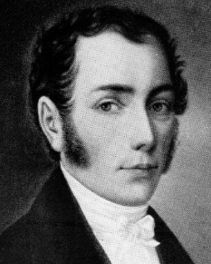
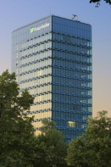
Fraunhofer-Gesellschaft
Our Eponym – Joseph von Fraunhofer
Joseph von Fraunhofer
The Fraunhofer-Gesellschaft
Discoverer of the »Fraunhofer Lines« in the solar spectrum
Researcher
Inventor
Entrepreneur
Research and development contracted by industry and government
New methods for grinding lenses
The mp3 music format, white LEDs, high-resolution thermal-imaging camera
Director and partner of a glassworks
Business volume: approximately €3.4 billion annually
8

Slide 9

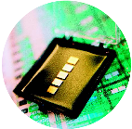


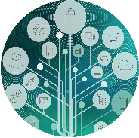
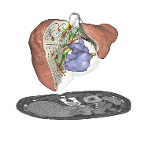
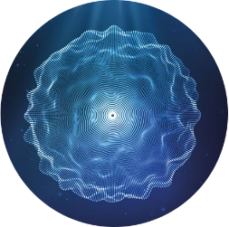

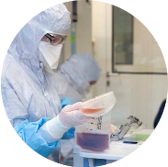
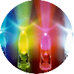
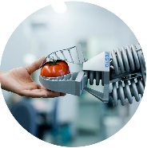

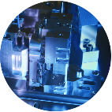
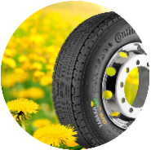
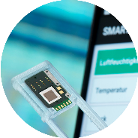

Fraunhofer Research
Highlights
mp3 Development of mp3 audio compression
Surgery with augmented reality Mobile image guidance for highly complex surgeries
AI voice assistant Data ownership with a smart voice assistant made in Germany
H₂ technologies Materials, systems and production technology for a sustainable H₂ economy
Care-O-Bot Service robot with reliable human-machine interaction
Lab-on-a-chip system Biological and microelectronic components on one chip
Industrial data spaces For secure and self-controlled data exchange
CAR T cells for cancer therapy Process for the complex production of cell specimens
White-light LED For energy-efficient and long-lasting lighting
Bionic handling assistant Robotic gripper modeled after an elephant’s trunk
Video compression H.264/MPEG-4 AVC standards for multimedia
Dandelion rubber Doubling the raw rubber in dandelions for industrial applications
High-security quantum network German pilot network for a tap- and tamper-proof data transmission
Femtosecond laser World record for the most powerful ultrashort pulse laser
Smallest pump in the world 25 mm² micromembrane pump
1990s
2000s
2010s
2010s
2020s
9
May 13, 2026

Slide 10
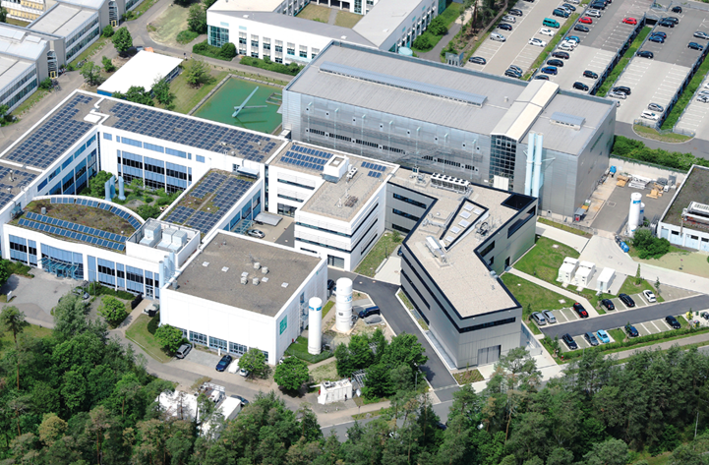



Fraunhofer Institute for Integrated Systems and Device Technology IISB
At a glance
Applied research ranging from crystal growth to devices, packaging, and high-performance electronic systems.
Partner Universities:

Slide 11
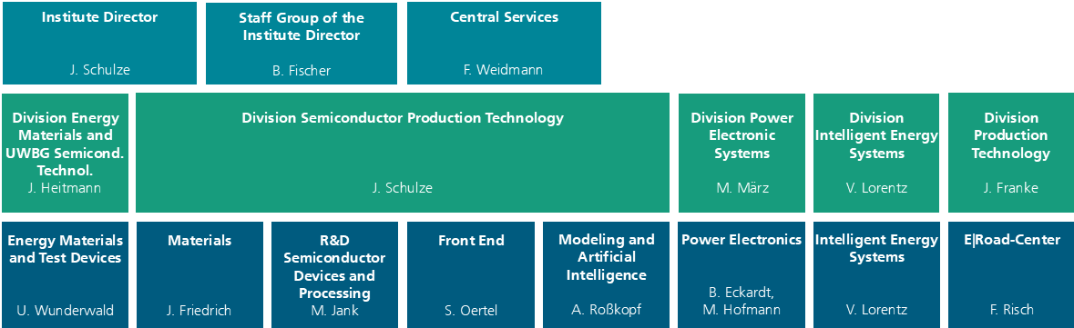
Fraunhofer Institute for Integrated Systems and Device Technology IISB
At a glance
Structure of the Fraunhofer IISB
University collaborations with the LEE (Prof. März), LEB (Prof. Schulze) and FAPS (Prof. Franke) at FAU Erlangen-Nuremberg, BayBatt at the University of Bayreuth (Prof. Lorentz), and TU Bergakademie Freiberg (Prof. Heitmann).
Fraunhofer IISB operates as a legally dependent entity of Fraunhofer-Gesellschaft zur Förderung der angewandten Forschung e. V.
Some IISB key figures:
Over 500 employees
Over 45 million EUR in annual revenue

Slide 12
Section 02
—
Introduction to DC-Grids
Notes:
Fraunhofer-Gesellschaft zur Förderung der angewandten Forschung e. V., lit. 'Fraunhofer Society for the Advancement of Applied Research'

Slide 13
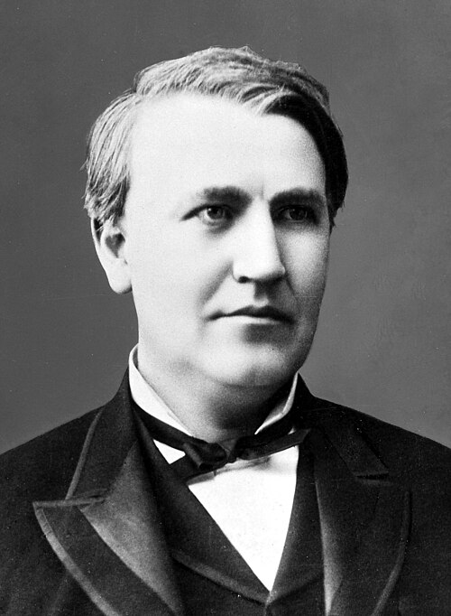
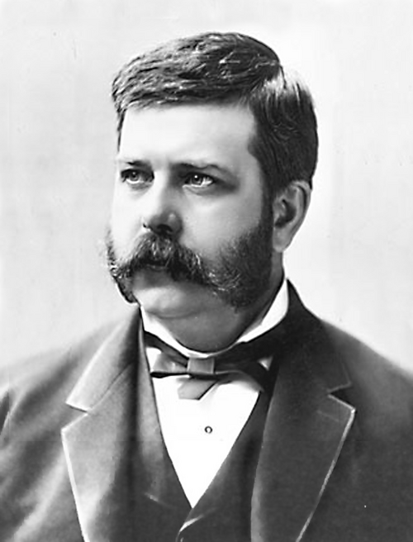
History
War of current ~1890
Thomas Edison
(1847-1931)
George Westinghouse
(1846-1914)
Initially small, regional island grids with 110 V
Used for arc lamps, carbon filament lamps, and DC motors
Problem:
Low voltages limits distribution range due to the lack of power electronics!
DC vs. AC
AC systems had grater transmission range due to higher voltages with help of transformers
AC comes naturally with generators
Problem:
Westinghouse faced patent issues with light bulbs (Edison controlled the market)
Images: Wikipedia
13

Slide 14
DC for Future
Sustainable development comes with DC
Renewable Energies
Photovoltaics
Battery Storages
Fuel Cells
Energy Distribution
Efficient long-distance engergy transmission with High-Voltage Direct Current (HVDC)
Modern Electronics & AI
Most elcectronics need DC (smartphones, computer, LEDs, …)
Data centers run with DC
Mobility and Living
Electric cars
Electric aviation for short distances
Smart Microgrids in private homes and commercial buildings
Modern Power Electronics
Naturally producing or consuming DC
Lower losses through eleminating unneccessary conversion steps
Reducing volume and complexity of systems

Slide 15


Advantages of LVDC Grids
AC vs. DC Installation
Voltage Levels¹⁾:
Transferable Power:
+750 V
Grid form | Maximum power at 16 A single wire load capacity | Cable cores²⁾
DC 380 V | 375 V · 16 A = 6,0 kW | 3
AC single phase, 230 V | 230 V · 16 A = 3,7 kW | 3
DC +/-380 V | 750 V · 16 A = 12 kW | 3 (4)
AC three phase, 400 V | √3 · 400 V · 16 A = 11 kW | 4 (5)
DC +/-750 V | 1.500 V · 16 A = 24 kW | 3 (4)
AC three phase, 690 V | √3 · 690 V · 16 A = 19 kW | 4 (5)
AC
+
L2
375 V
L1
L3
+375 V
+375 V
PE
375 V
DC
0
750 V
1,5 kV
$$+$$
$$−$$
PE
-375 V
²⁾ including PE, in brackets with neutral conductor
−
375 V
Less copper or more transmittable power with DC technology
-750 V
¹⁾ 1,500 volts form the low voltage limit according to Directive 2014/35/EU (Low Voltage Directive)

Slide 16
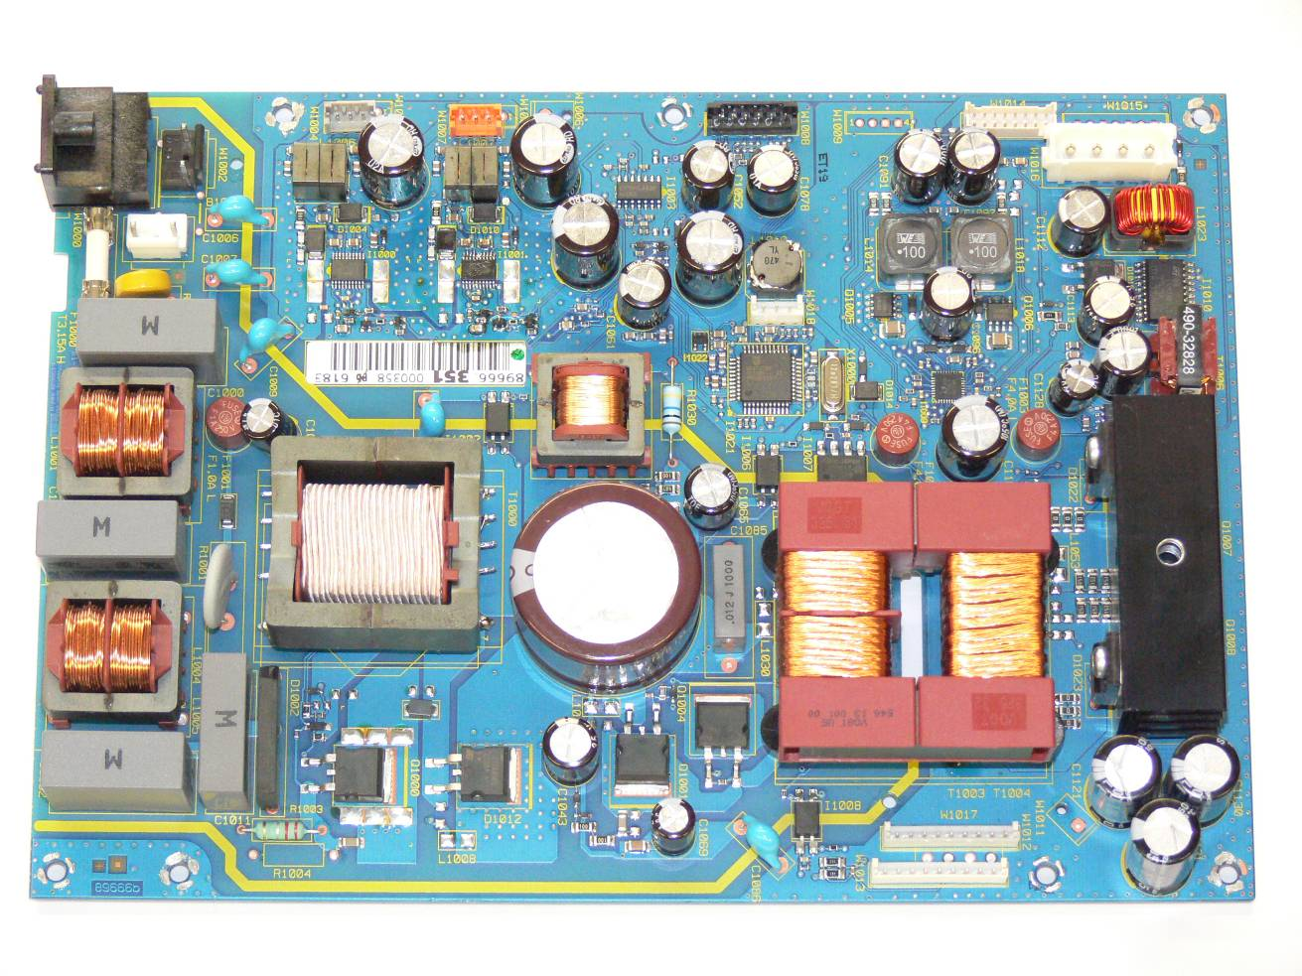
DC Grids for Decentral Energy Systems
A typical AC power supply
AC grid voltage in V
t
AC grid voltage in V
EMI filter
PFC
Energy
storage
t
due to AC grid supply
for personal safety

Slide 17
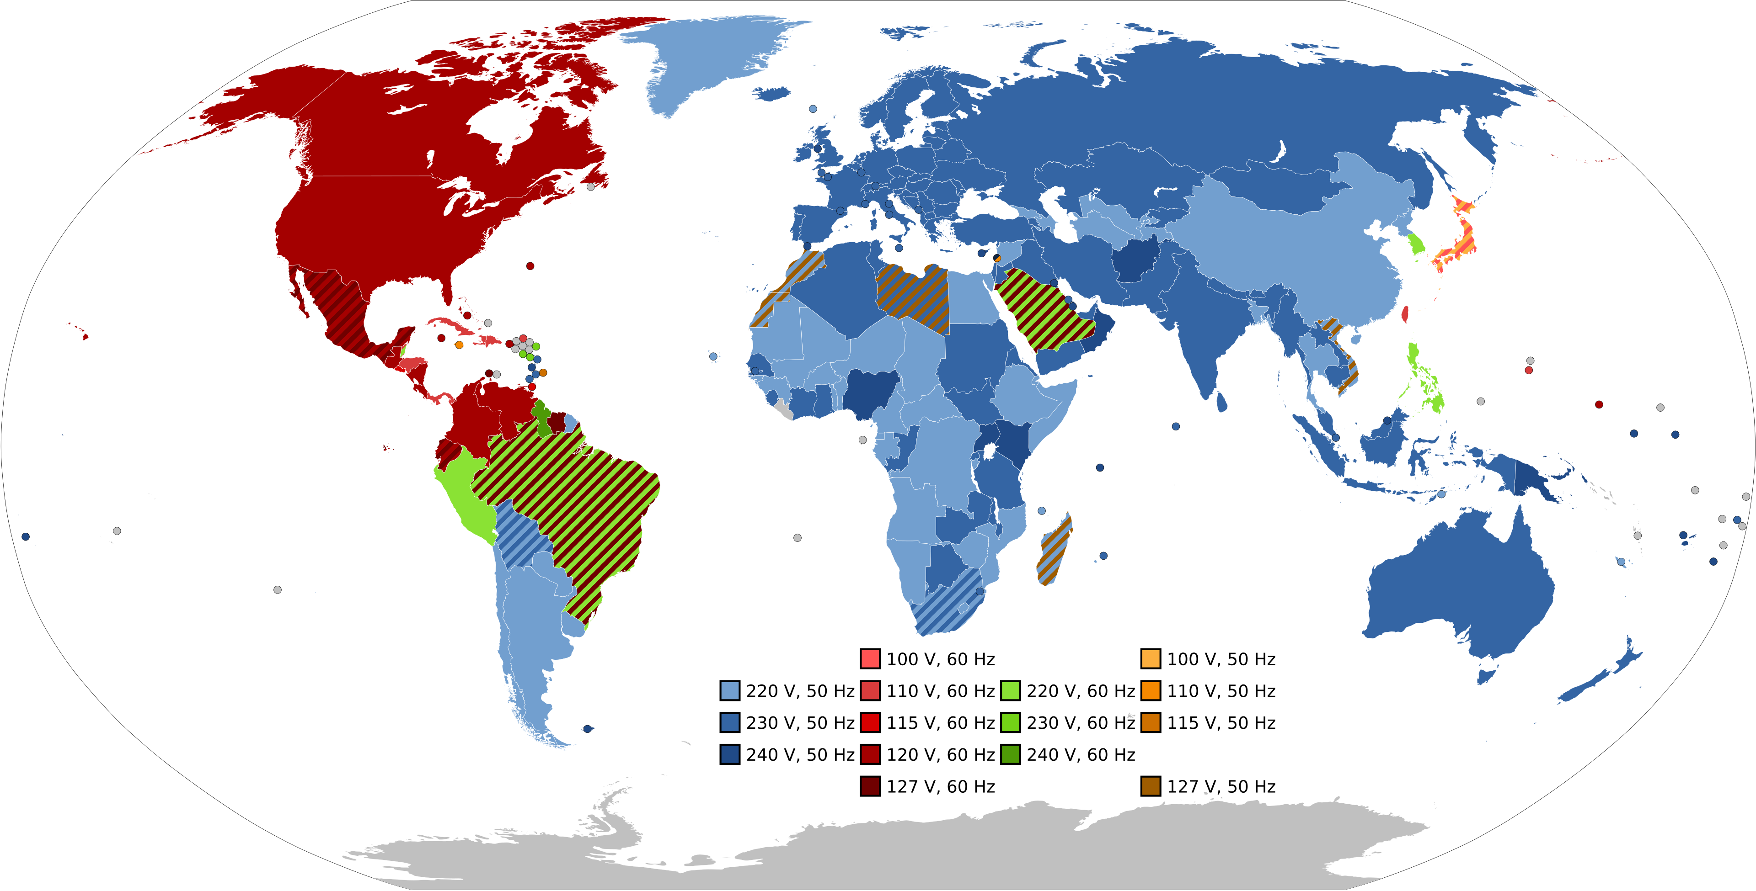



DC Grids for Decentral Energy Systems
Why 380 V?
Most countries are using 200 V to 240 V low voltage
Regardless of whether a device runs on AC or DC, a PFC first generates a DC link voltage between 380 and 400 V.
→ DC can be bypassed
Image: Wikipedia (Author: SomnusDe)
$$+380 V$$
DC 380 V
AC grid voltage in V
$$240 V∙110 \%∙\sqrt{2}=373 V$$
t
AC 90…240 V
DC 380 V
$$−380 V$$
AC frontend

Slide 18
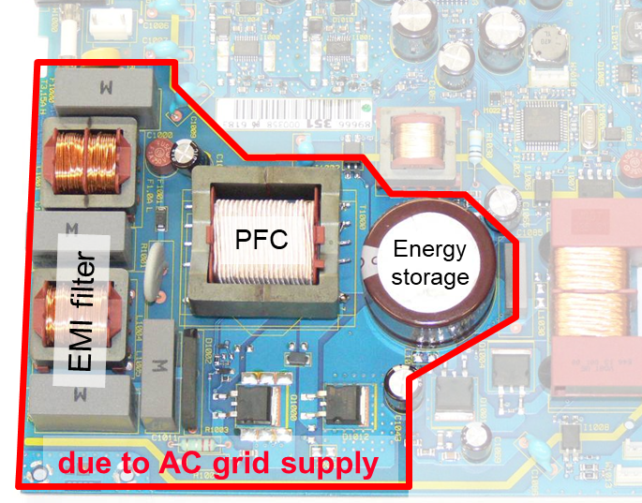


A typical AC power suppy
AC grid voltage
50(60) Hz
$$u\left(t\right)= \hat{U}⋅\sin{(ωt)}$$
AC grid power
$$p\left(t\right)= \overline{P}⋅\left(1−\cos{(2ωt)}\right)$$
mean output power
t
One hundred supply gaps per second require a considerable amount of energy storage capacity in each power supply!
⇨ With a drastic impact on Size, Cost and Energy efficiency
All the advances in power electronics (e.g. miniaturization by increasing the switching frequency) cannot take effect here, as the AC-grid frequency is fixed!

Slide 19

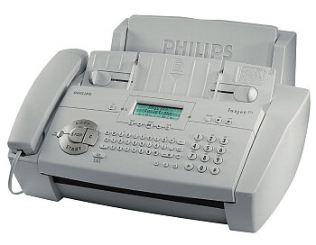
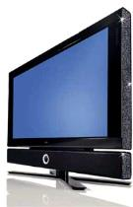
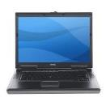


Equipment Power Supplies and Line Adapters
Supply from AC grid is responsible for
40...80% of losses
50...95% of weight
50...95% of volume
of the AC power supply in each electronic equipment!
A typical AC power suppy
PFC
Energy
storage
EMI filter
due to AC grid supply
for personal safety

Slide 20
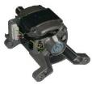


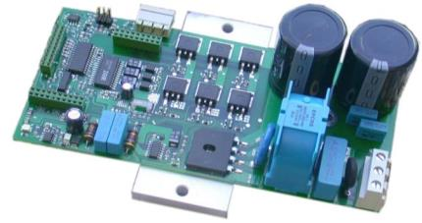


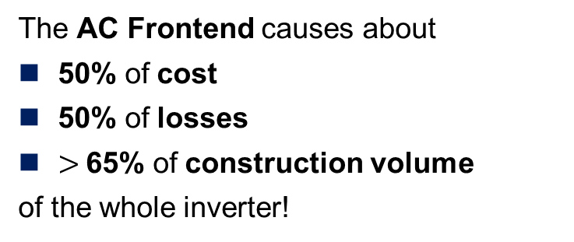
Variable Speed Drives
DC
The AC Frontend causes about
50% of cost
50% of losses
$>$65% of construction volume
of the whole inverter!
AC
AC
~
AC frontend
$$η=0,97$$
$$η=0,97$$
AC supply is often a
Cost Driver and Efficiency Killer

Slide 21
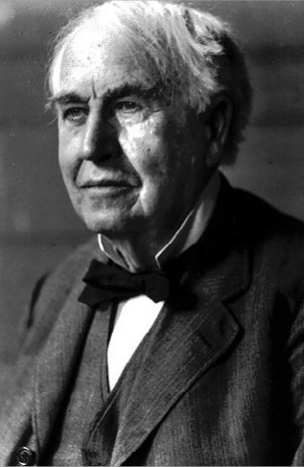
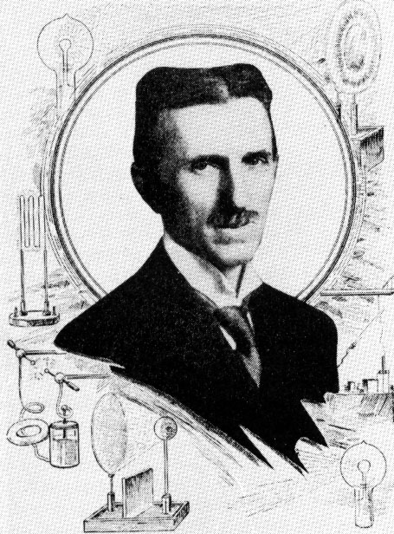
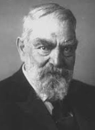
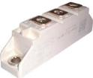

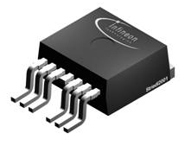
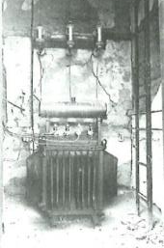
Zentrale technische Randbedingungen haben sich verändert!
Oscar von Miller
1885 1960 1970 1980
Si Leistungsdioden Leistungsmodule
Bipolar-Leistungstransistoren
IGBT
Leistungs-MOSFET
Transformator
Lange Zeit die einzige Möglichkeit zur statischen Umformung elektrischer Energie (funktioniert nur mit Wechsel- spannung)
Leistungselektronik
erlaubt heute die flexible und hoch effiziente Umwandlung elektrischer Energie von jeder in jede gewünschte Form.

Slide 22
Weitere Themen
Vorschungsfelder Adrian / Moritz
Topologien?
Komponenten von DC-Nezten (PV, Batterie, Schutzschalter)?
Regelung/Stabilität von DC-Netzen

Slide 23
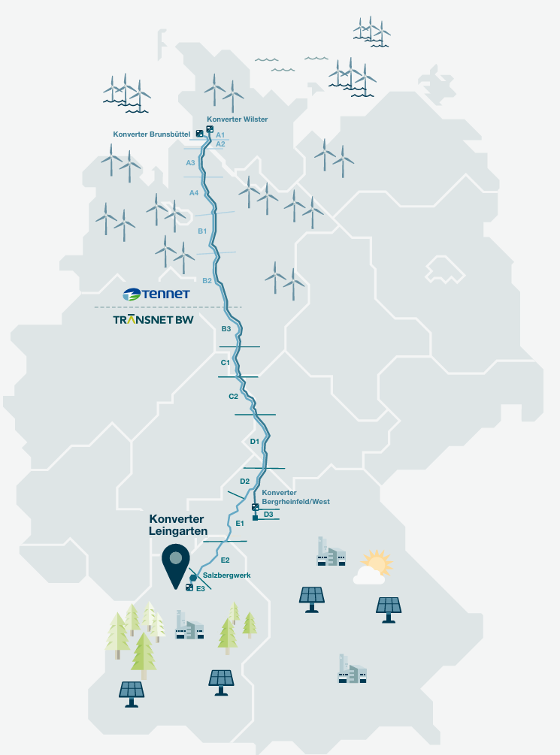
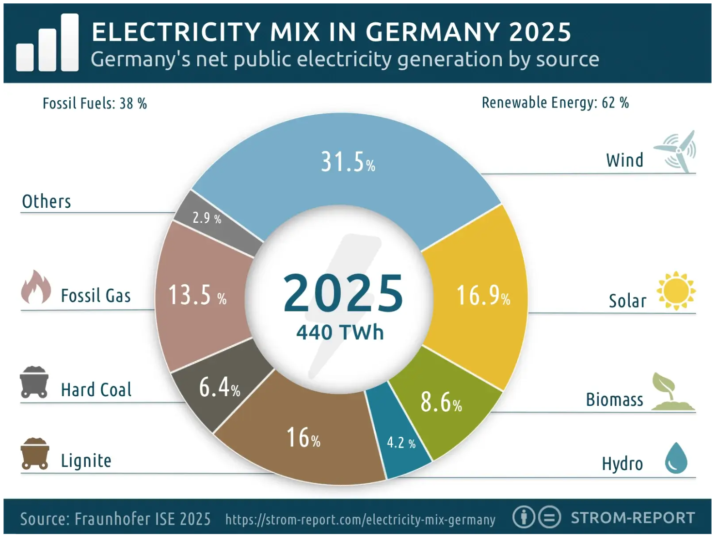
German HVDC-Network “Südlink”
Overview
Two parallel ±525 kV HVDC underground cable systems, each 700 km
Combined rated capacity of 4 GW (-> 7600 A)
Designed primarily to transport wind power from northern to southern Germany.
MMC (Modular Multilevel Converter) Topology: Voltage Source
Interfaced with 380 kV AC grid
Black-Start Capable
Reactive Power Compensation
Part of Germany’s transition to renewable Energy

Slide 24
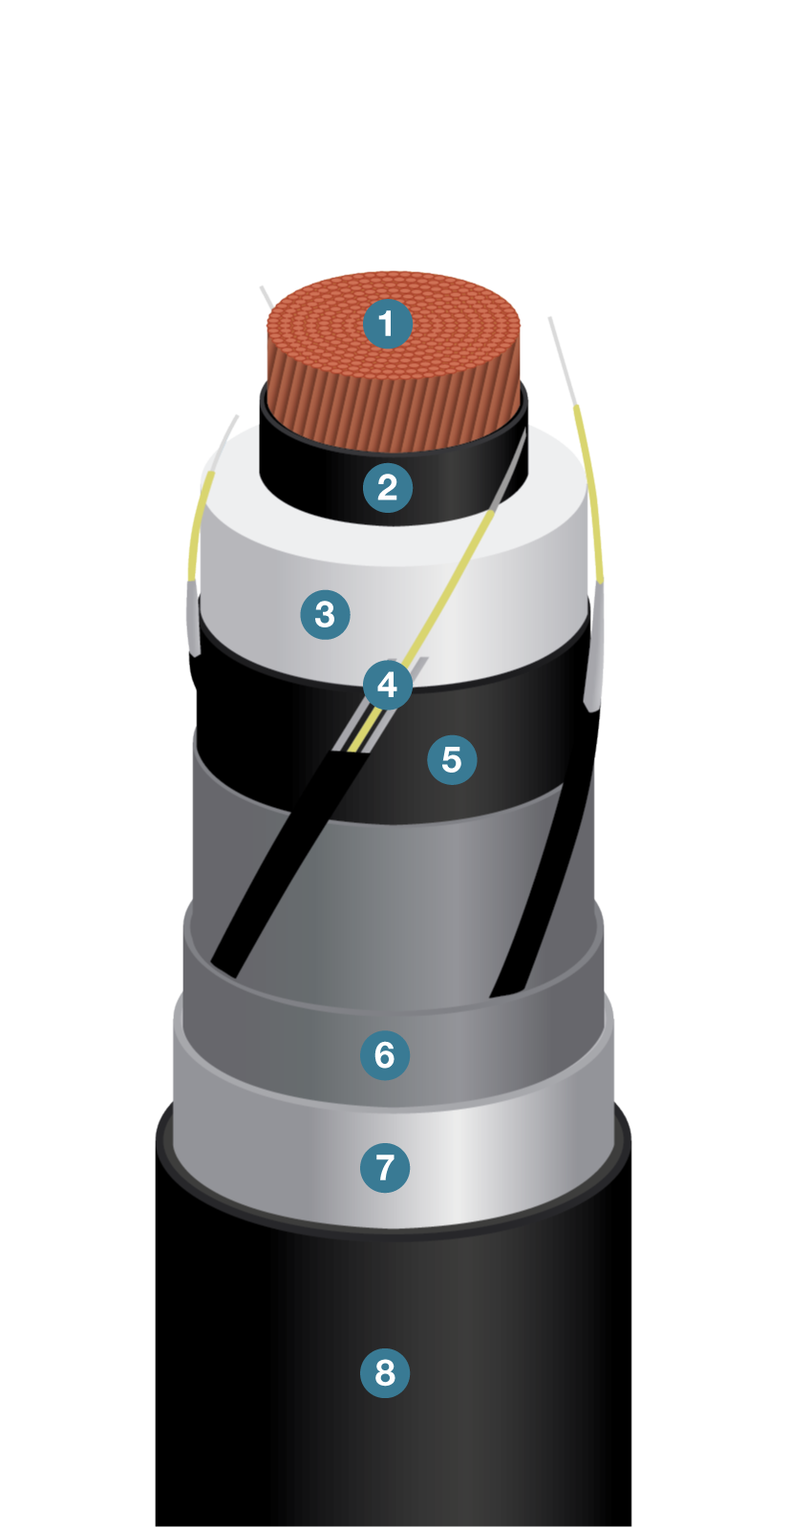
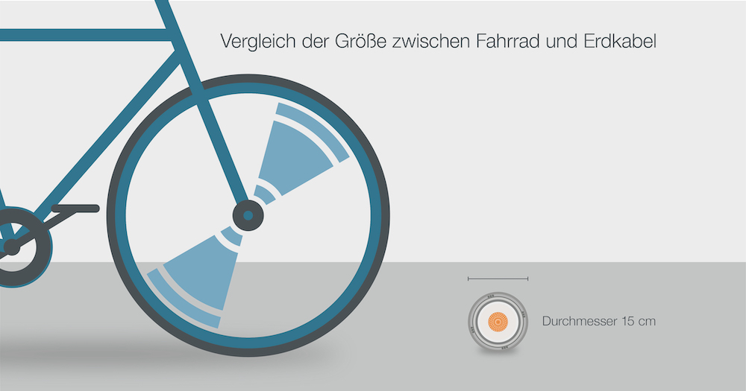
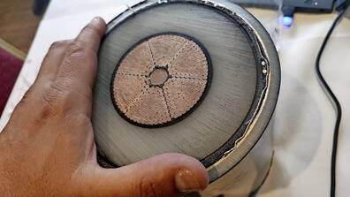
German HVDC-Network “Südlink”
The cables
1 Copper Conductor 2 Semi-Conductive Material for a smooth E-Field 3 Insulation (likely Polyethylene) 4 Semi-Conductive Material 5 Fiber-Optic Cables 6 Aluminum Shield 7 Second isolation layer 8 Outside Isolation against environmental influences, moisture, and mechanical damage
Estimation: 250 kV over a distance of 25 mm -> 10 kV/mm
5
4
https://www.haz.de/lokales/umland/neustadt/suedlink-in-neustadt-grosse-transporter-liefern-kabel-fuer-stromtrasse-DWAQPQIG5PCYHQMKWUJHXWEQY4.html
https://suedlink.com/s-h

Slide 25
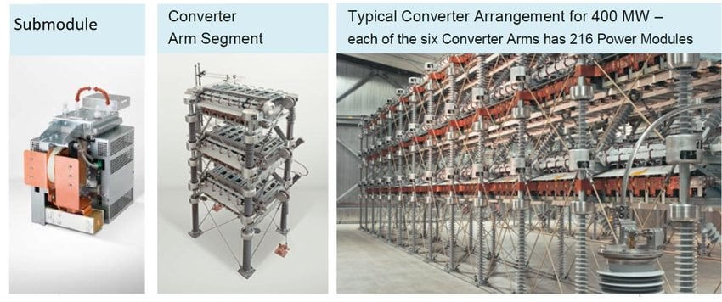
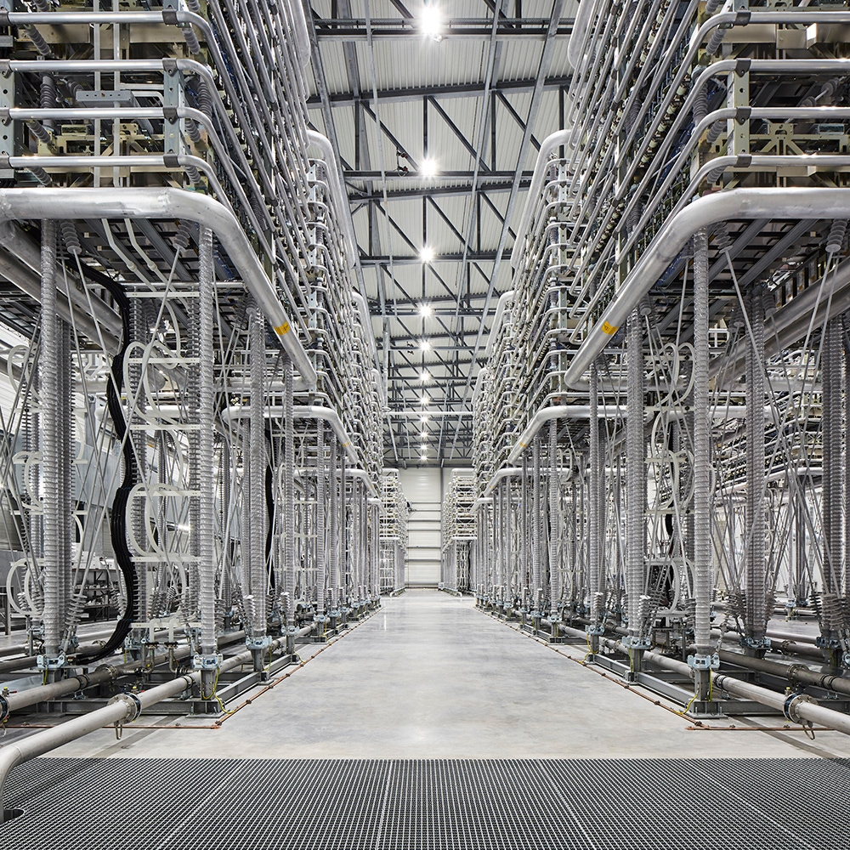
German HVDC-Network “Südlink”
MMC Converter
1 Copper Conductor 2 Semi-Conductive Material for a smooth E-Field 3 Insulation (likely Polyethylene) 4 Semi-Conductive Material 5 Fiber-Optic Cables 6 Aluminum Shield 7 Second isolation layer 8 Outside Isolation against environmental influences, moisture, and mechanical damage
Estimation: 250 kV over a distance of 25 mm -> 10 kV/mm
https://www.haz.de/lokales/umland/neustadt/suedlink-in-neustadt-grosse-transporter-liefern-kabel-fuer-stromtrasse-DWAQPQIG5PCYHQMKWUJHXWEQY4.html
https://suedlink.com/s-h

Slide 26
Thank you for your attention!
ご清聴ありがとうございました
—

Slide 27
Contact
—
Adrian Keil, M.Sc.
Intelligent Energy Systems
Tel. +49 9131 761-527 adrian.keil@iisb.fraunhofer.de
Fraunhofer IISB
Schottkystraße 10
91058 Erlangen
Germany
www.iisb.fraunhofer.de
Moritz Bosch, M.Sc.
Intelligent Energy Systems
Tel. +49 9131 761-458 moritz.bosch@iisb.fraunhofer.de
Fraunhofer IISB
Schottkystraße 10
91058 Erlangen
Germany
www.iisb.fraunhofer.de

